Slide 1

Wellcome Leap 1kD Modeling & EEG WG meeting
The First 1000 Days
PROMOTING HEALTHY BRAIN NETWORKS
31/5/2023

Slide 2
Goal:
To understand the early predictive biomarkers of EF, Recovery, and other features

Slide 3
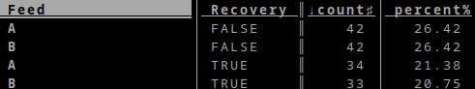
Recovery
 | FeeFd A | Feed B
Did not recover | 28 | 22
Recovered | 16 | 10
Chi-squared pval = 0.83

Slide 4
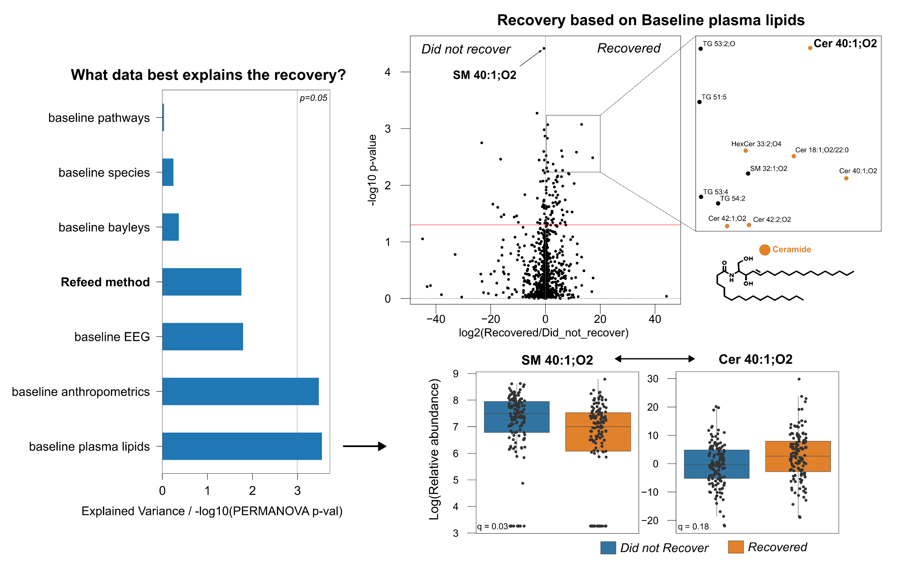

Slide 5
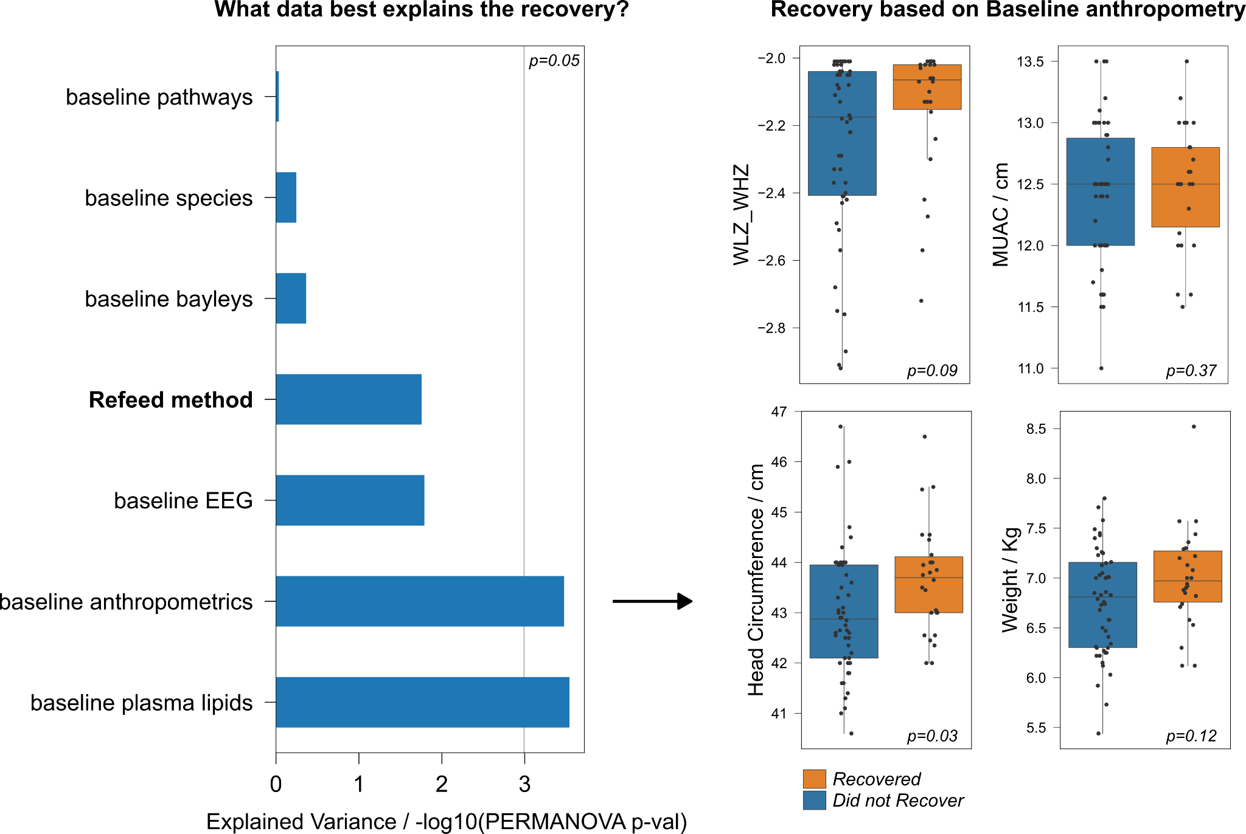

Slide 6
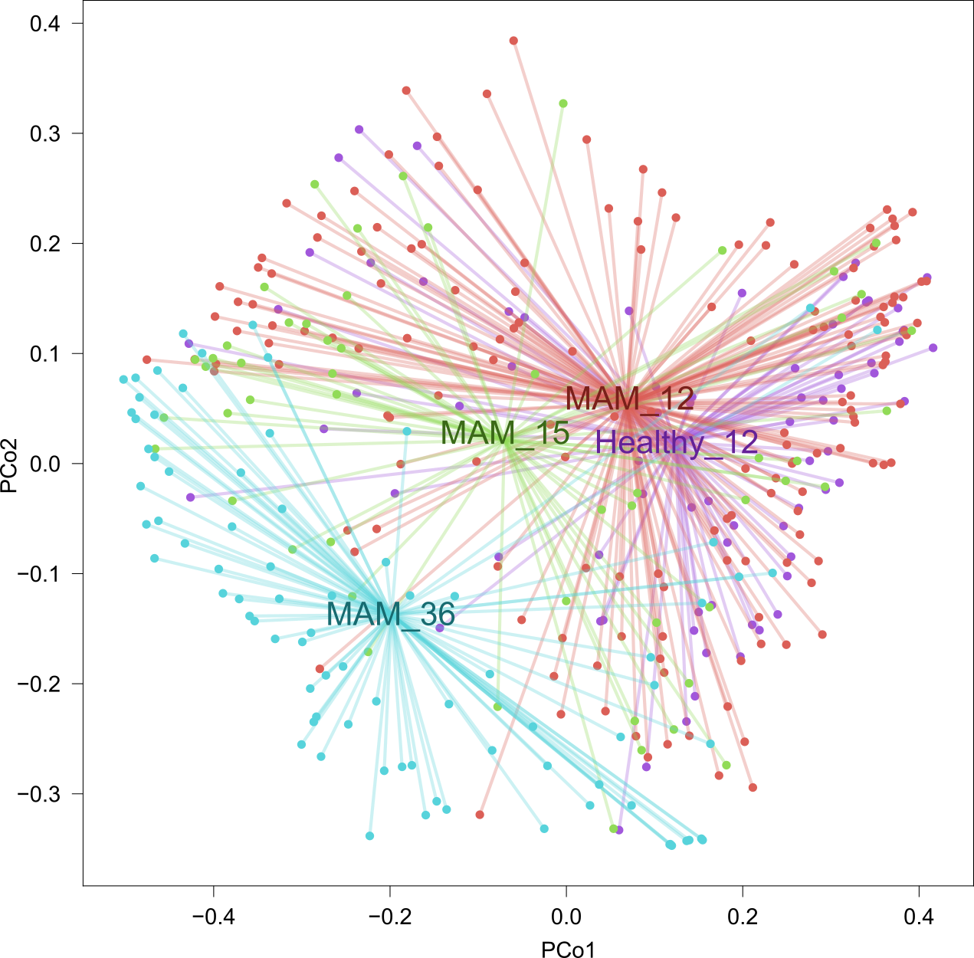
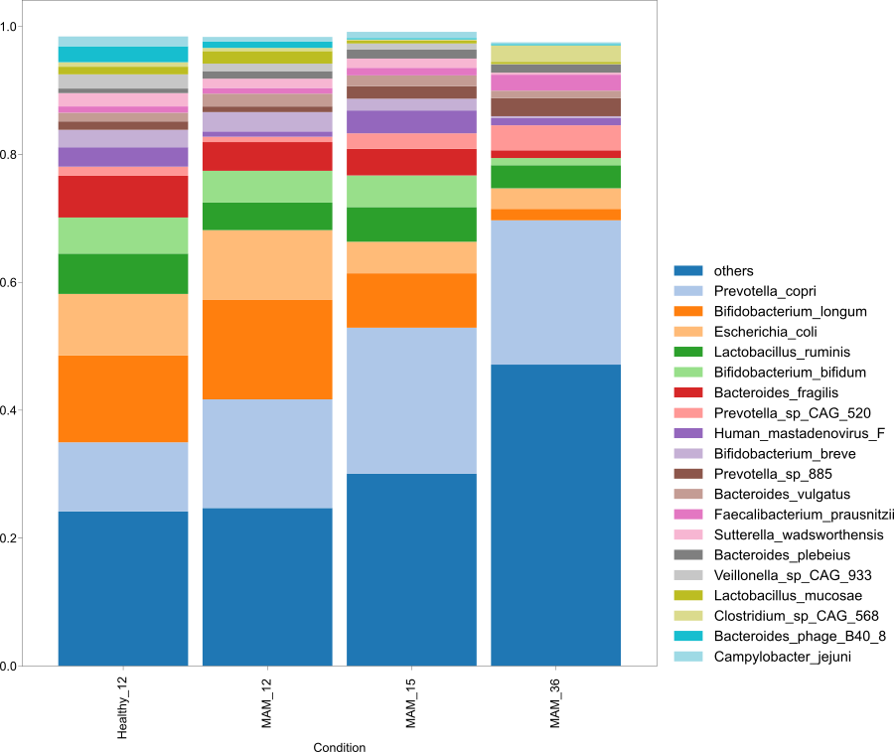

Slide 7
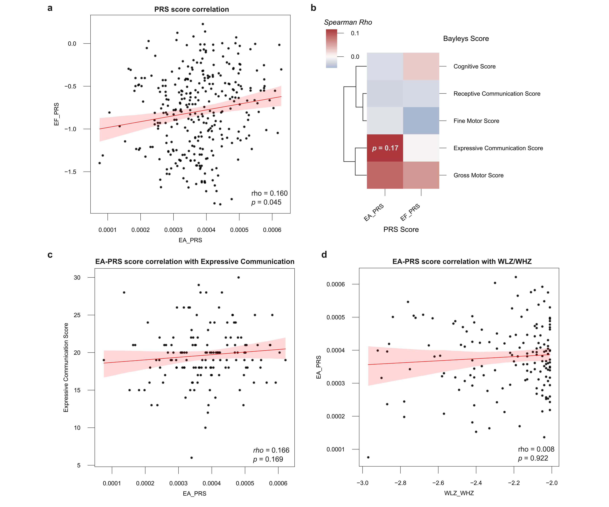

Genetics
PRS scores for Executive function (EF) and for Educational attainment (EA) are highly correlated.
EA-PRS is correlated with Expressive communication
Page 7 of 9

Slide 8
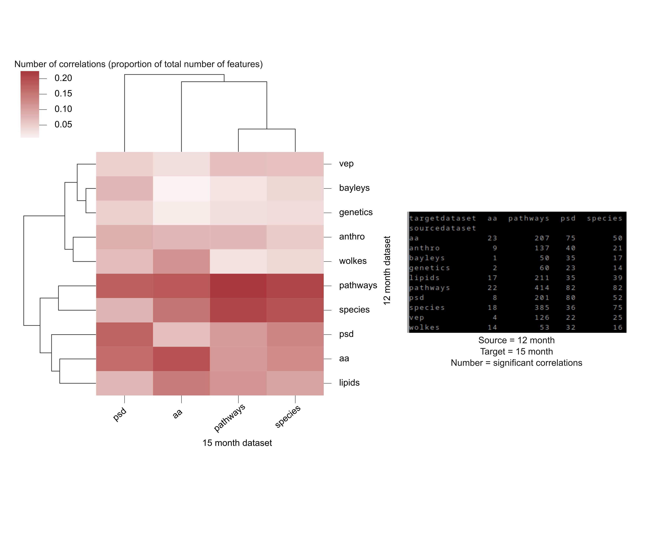
A multi-omics longitudinal approach

Slide 9
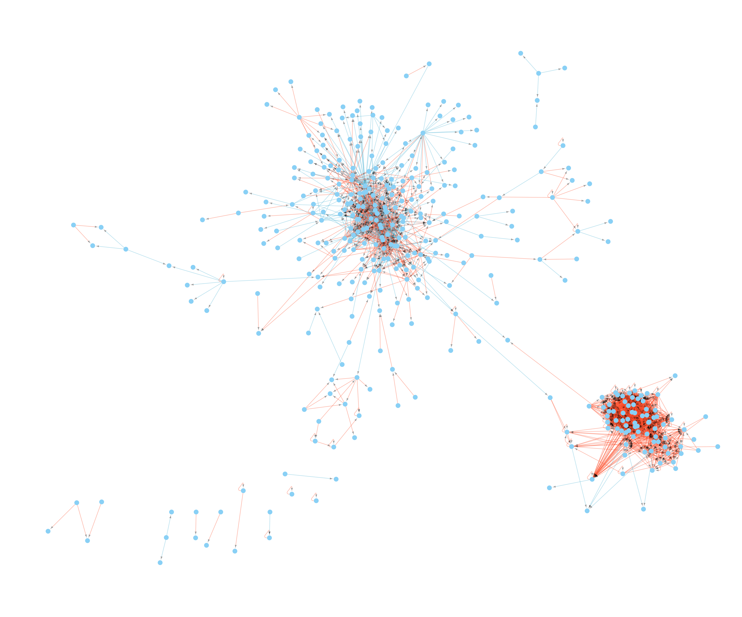
A multi-omics longitudinal approach
Directional network was created based on the correlation of a variable at 12 months with another variable at 15 months following refeeding
EEG cluster
MAM cluster
Page 9 of 9

Slide 10
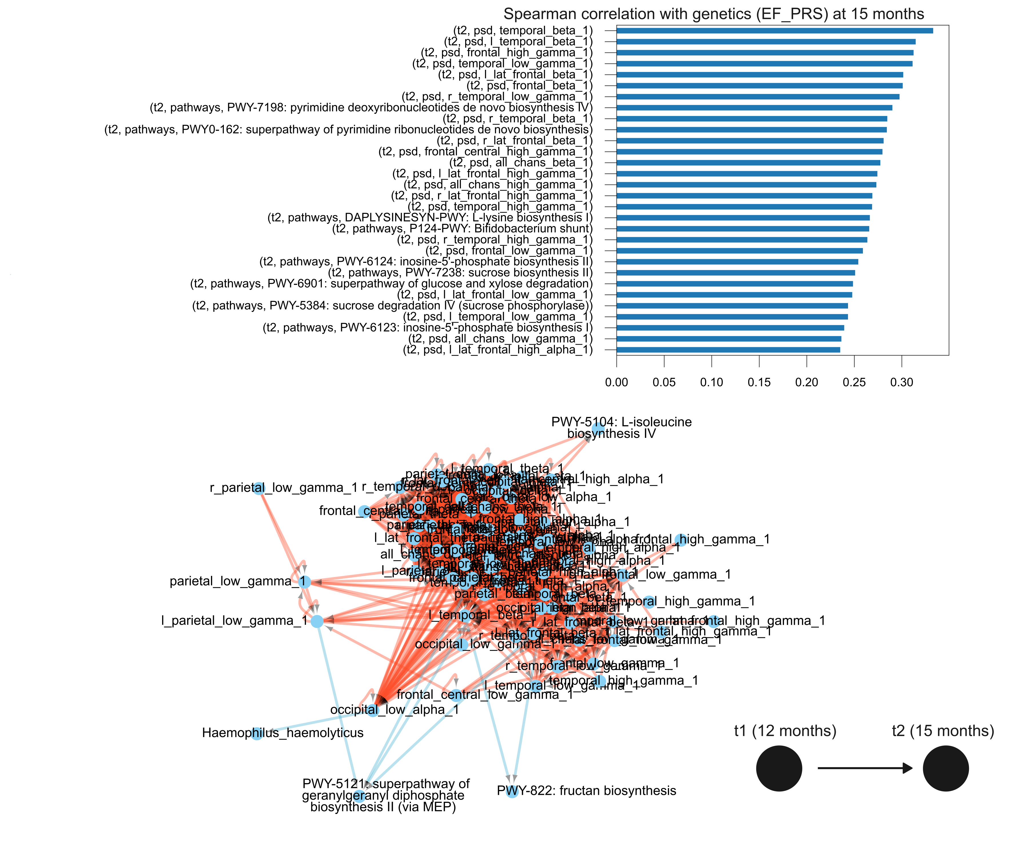
A multi-omics longitudinal approach
EEG CLUSTER
Genetics are highly correlated with EEG PSD
Baseline EEG PSD values are highly correlated with recovery EEG PSD measurements
Page 10 of 9

Slide 11
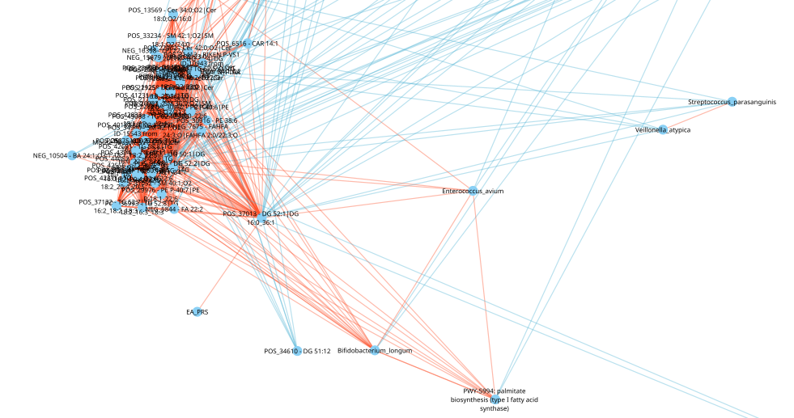
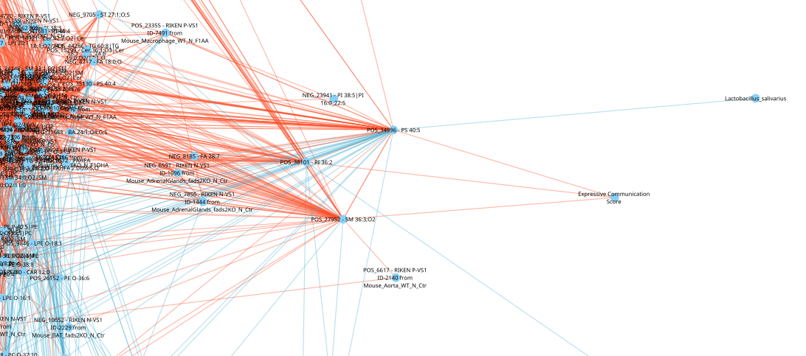
Genetics (EA_PRS) also associated with plasma diglycerides that negatively associate with Streptococcus and Veillonella in the gut
Bayleys are also linked to plasma lipids

Slide 12
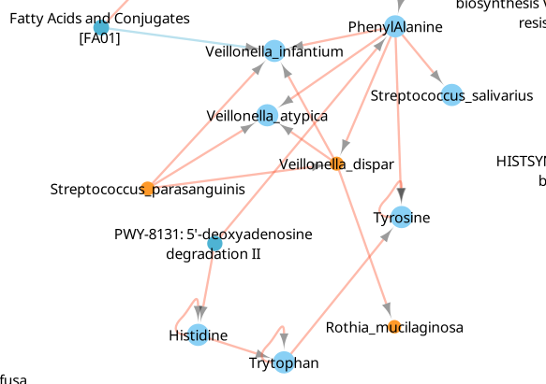
A multi-omics longitudinal approach
- MALNUTRITION CLUSTER
Veillonella and Streptococcus species are enriched in malnutrition and predict one another across time.
Baseline Phenylalanine is enriched due to malnutrition and is associated with the abundance of
Baseline Fatty Acids interrupt this system
Page 11 of 9

Slide 13
